Slide 1
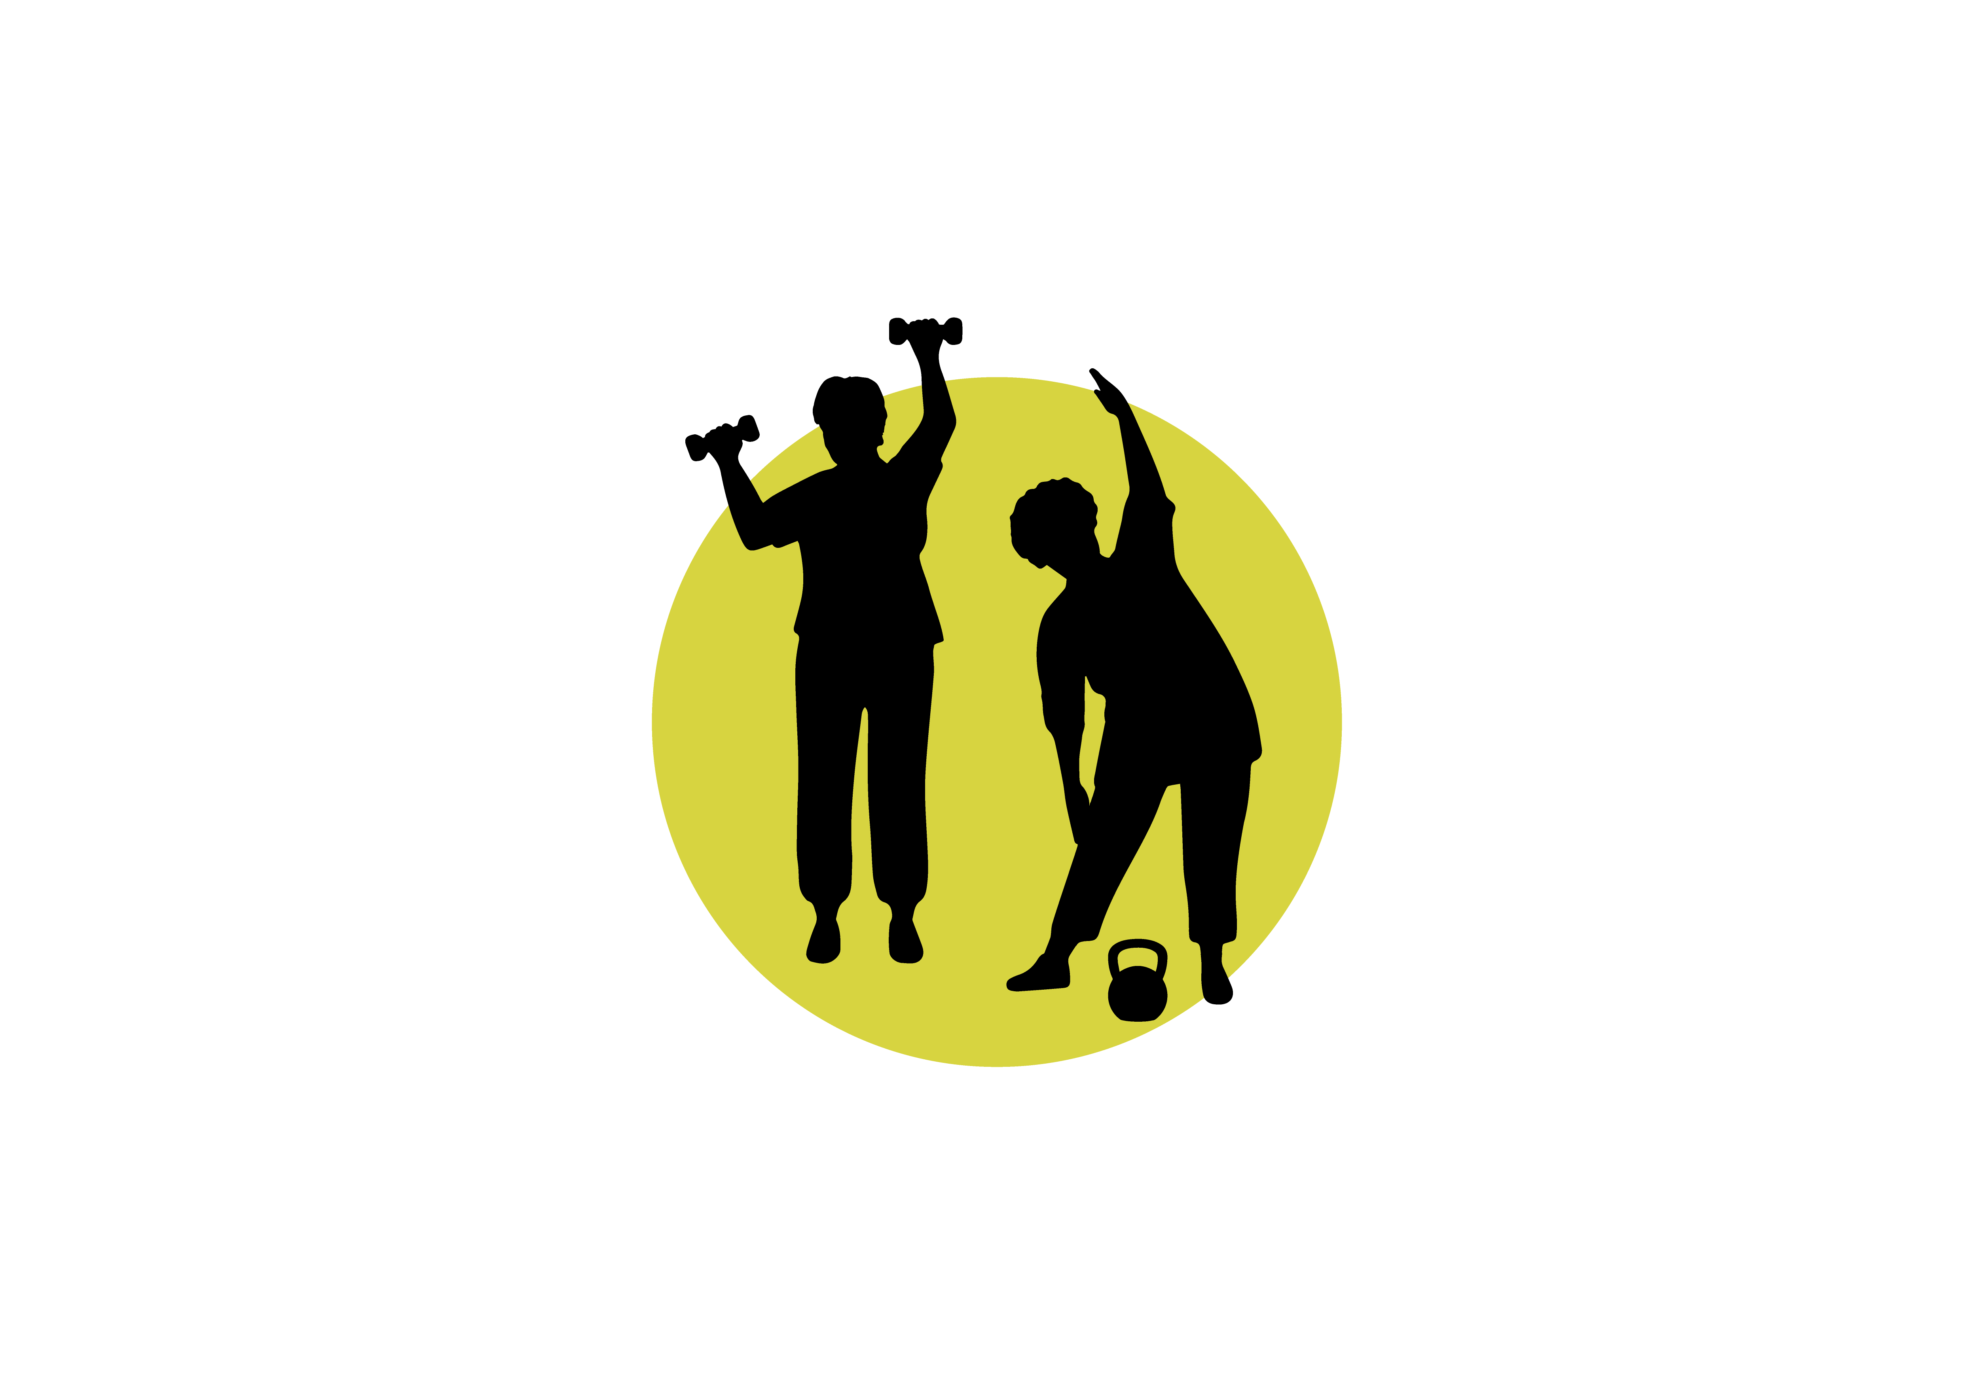
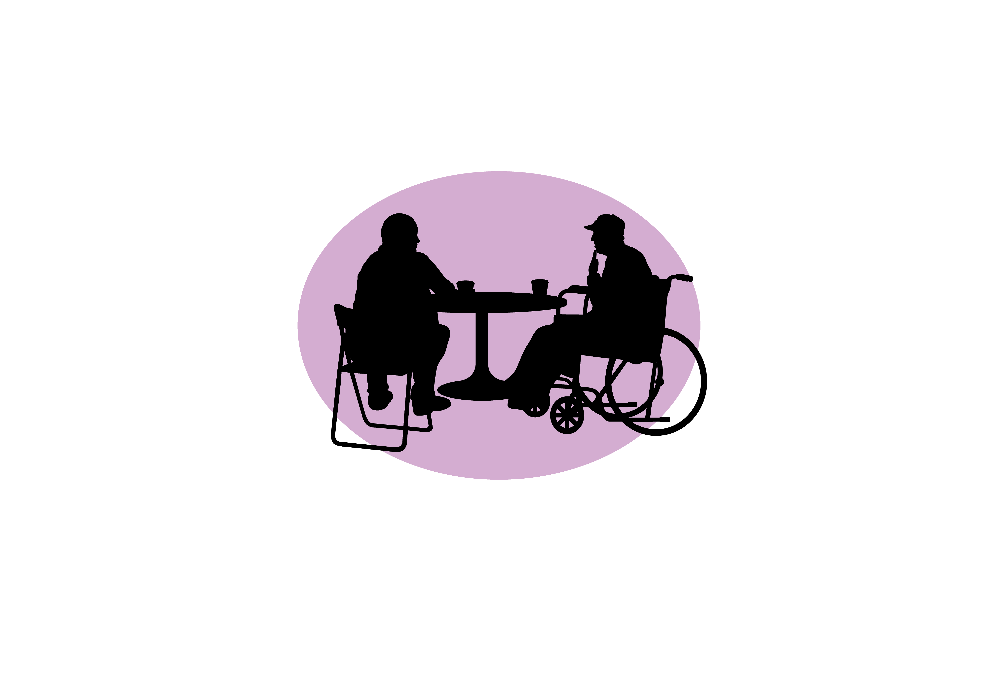
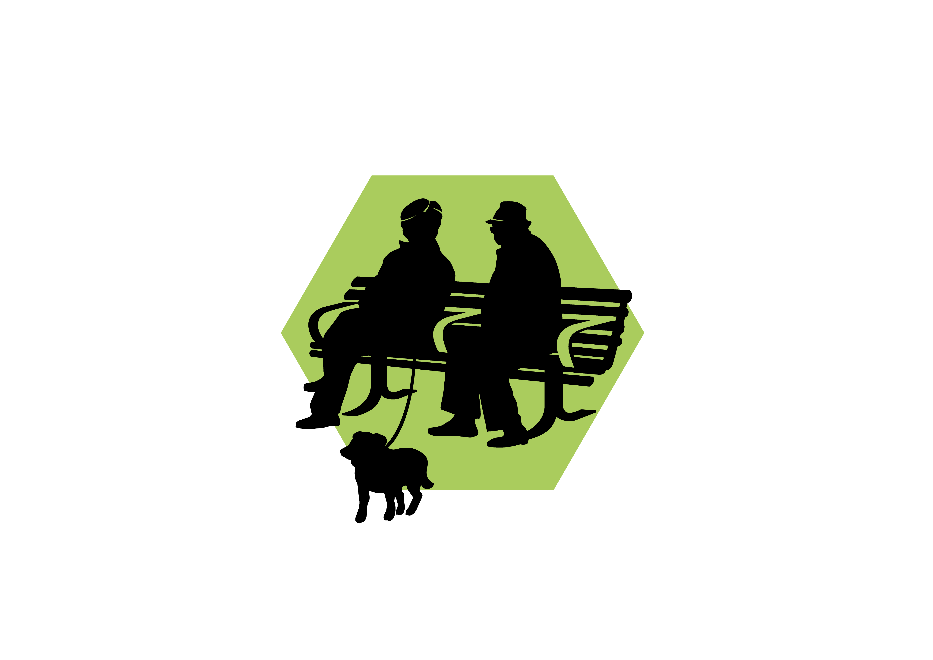


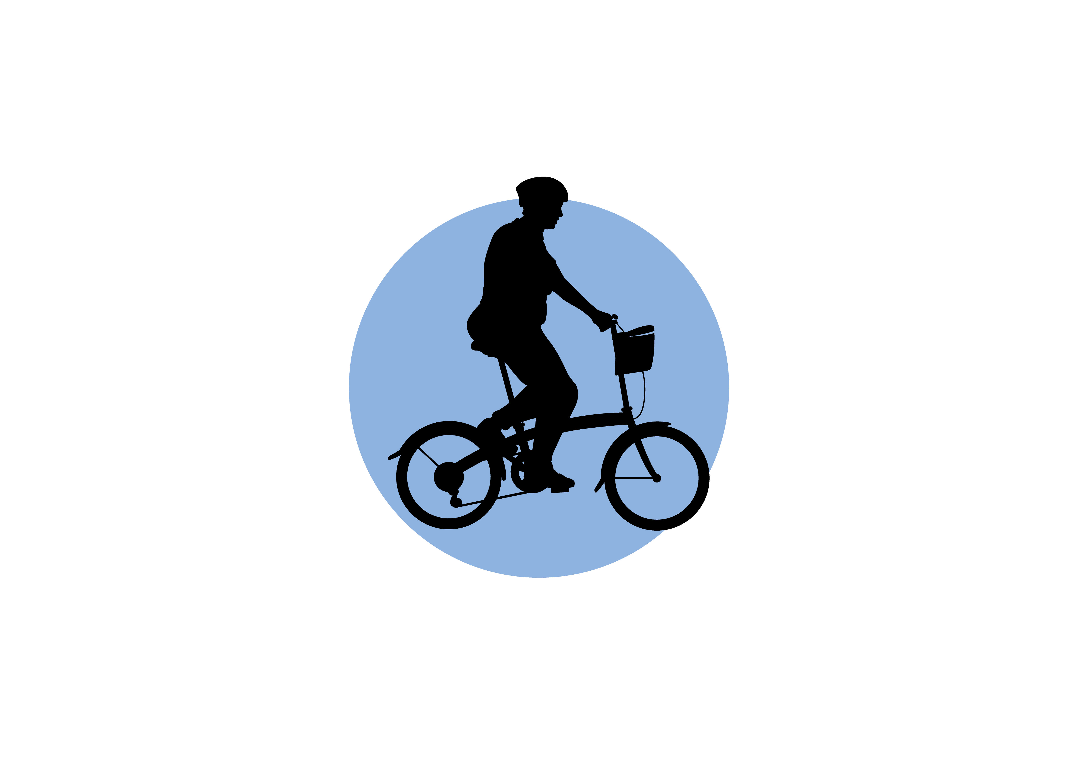
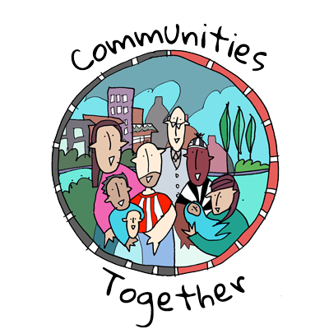







‘Ageing Well in Whitfield’ Pilot (North Stoke Project 2025-2026) Early architecture of a neighbourhood health approach, rooted in prevention, collaboration, and local assets

Slide 2
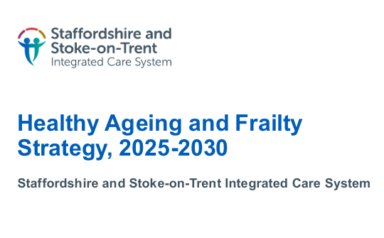
Why Ageing Well in Whitfield?
Preventing & Managing Frailty in Stoke-on-Trent conference
Chaired by
Jon Rowse & Neil Carr
Invitation made to collaborate
(Within frustration, anger, apathy, scepticism, political tension, curiosity, positive intention)
Intention set:
Listen to and act with community
‘Case for Change’
North Stoke workshop series:
1 Online 2 Fegg Hayes 3 Swan Bank 4 Chell Heath
Stoke-on-Trent residents lose 10 years of healthy life earlier than national average and experience earlier frailty.
Learning by trial: “Start small with willing partners to test ideas, build trust, and create quick, visible wins that can be expanded as confidence and collaboration grow.”
Collective Impact Forum

Slide 3



Developing community insight and a shared understanding of frailty through community workshops
How does frailty impact people’s lives in your community?
How do you experience people not living or ageing well?
Whose resilience / ability to ‘bounce back’ is at risk in your community
What or Who is helping people feel supported, connected, resilient and well in your community?
What do we need to do more of?
What gets in the way of people accessing help ?
What and Who is needed to make this happen ?
Whose voices need to be heard to understand their experience and perspective?
How will we know when we have had an impact/made a difference?
Beginning with people’s strengths, not their deficits.
Recognising frailty as modifiable, shaped by fitness, environment, and social connection.
Using conversation, storytelling, and relationship‑building to surface local wisdom.
Co‑creating language, insight, and action that the community owns.
Supporting a cultural shift in how ageing and frailty are understood toward optimism, agency, and collective capability.
Notes:
We held four community workshops — online, at Fegg Hayes, Swan Bank, and at Chell Heath. Each one helped us surface strengths, stories, and lived experiences around ageing and frailty.

Slide 4















Ageing Well in Whitfield collective

Slide 5
Ageing Well in Whitfield narrative
Together, we want to design ideas that help people feel well, stay active, and get support earlier.
Ways we hope to help people
Stay strong: Move your body, care for your mind, and stay social.
Spot things early: Simple checks and screening help us notice changes sooner.
Reduce pressures, help with worries, confidence, money or home issues that make life harder.
Get support for health conditions and troubles: Find the right help and support when you need it.
Look after ourselves and our community
How you can get involved
Work with us if you get an invitation.
Tell us what matters to you.
Join a chat or event in your area.
Try local groups and activities.
Give feedback so we can learn what works.
Stay in touch and bring a friend.

Slide 6
What We’ve Done So Far: Building a Neighbourhood Model
Monthly Ageing Well in Whitfield Collective established
PHM cohort ID:
274 residents, risk segmented: missed BP check /mental health flag/~£5000 systm cost
Neighbourhood Activity Calendar established and updated monthly to fix outdated online listings.
Strength-based ‘What Matters’ conversation tool developed + integrated safety/frailty prompts.
Opt‑out / in / cold call invitations via GP practices test → to reduce inequality in access.
Health literacy kind intention set → kind, understandable, accessible
VCSE + live community calendar → integrated neighbourhood connection social prescriber model agreed
Safety & early identification pathways explored (frailty, meds, falls, isolation, mental health).
Shared intelligence collection tools identified (Joy+QRIOS+CFS App) → common outcomes, MDT learning.
Evaluation framework development
Commissioning models explored
Interim funding model agreed
Test of Change agreed and underway
+ cohort/resident invitation to be co-producers
Feedback mechanisms identified with aim to build trust and credibility.
Intervention co-design: Key ingredients to ’Healthy Ageing’ collectively agreed with supporting narrative
Prevention-first, Person‑centred, Community‑rooted.
NDTi Wellbeing Questions Framework | NDTi
Joy
CFS APP — Specialised Clinical Frailty Network
hct-final-evaluation-report-21-july.pdf
Notes:
“This is where the prevention-first, person-centred bit stops being a slogan and starts being a practice.”
“This is where community and system start to feel like one team.”
Learning has fed into a neighbourhood model that is practical, prevention-focused, and completely grounded in community partnership.
Data tools employed eFI and the PHM Pathfinder to identify a cohort of 274 residents at risk — people with missed blood pressure checks, mental health flags, and higher system usage. That gave us a clearly defined group for early, preventive support.
Opt-out invitations through GP practices, to avoid creating barriers for people who don’t usually seek help. Strength-based conversations that explore what matters, someone’s confidence, their motivation, and the small things that help them keep going. A VCSE home organisation model, so everyone has a starting place in the community — not just in clinical settings. Safety and early identification checks on frailty, falls, medication risk, isolation, and mental health. And shared intelligence through Joy, QRIOS, Frailty Scale tools — helping us track what’s changing across the neighbourhood.
We’ve also created a neighbourhood activity calendar, because the community told us, “There’s a lot going on but it's not visible or connected.” So the calendar now holds everything in one place and is updated monthly, not left to go stale like many online listings.
And we designed our ‘What Matters’ strength‑based conversation tool, which includes the safety and frailty prompts that help us pick up concerns earlier. This has been co‑designed across partners.

Slide 7
Community learning
“There is a lot going on but it’s not visible or connected.”
People want confidence, connection, simple access.
Barriers: transport, low mood, health literacy, loneliness, limited trust.
Support must feel kind, local, human and joined‑up.
Notes:
“People don’t talk in the language of structures. They talk about who they trust.”
This feedback has really shaped our emerging model and the shift from doing things to people, to working with them.

Slide 8
Collective agreed key ingredients to Healthy Ageing. Developed from evidence and community insight
Healthy Living
Move your body: Exercises that help with strength, balance, and flexibility.
Spotting Problems Early
Simple checks: Use tools to find out who might need help soon.
Mixed Support
Many types of help at once:
Eat well: Make sure older people get the right food to stay healthy.
Regular check-ups: Blood pressure, fats and sugars, annual review, eyesight, hearing, smoking or drinking.
Safe homes: Make homes safer to prevent falls (like better lighting or handrails).
Whole-person check: Look at physical health, feelings, social life, and home situation.
Personal plans: Make a plan that fits each person’s needs.
Team support: Health workers, social workers, community pharmacy and others work together.
Check for fall risks
Review medicines
Give advice on food and exercise
Offer social support
Make homes safer
Staying Social
Make friends: Befriending services and social groups.
Join in: Places where older people can meet, chat, and do activities.
Fight loneliness: Help people feel connected and part of the community.
Volunteering: Helping people have a sense of purpose and improve confidence.
Address peoples emotional, spiritual and psychological needs
Check for bereavement support needs
Access to knowledge and learning
Digital and Health literacy support
Look after your mental health needs: Reduce stigma of mental health and enhance awareness
Specific checks: Encourage and support national screening programmes are used and accessible e.g. breast, bowel, prostate
Support for carers

Slide 9
Collective agreed key ingredients to Healthy Ageing. Developed from evidence and community insight
Working Together
Different services team up:
Making Help Easy to Use
Feels kind and accessible
Trained Helpers
Ageing Well / Health literacy trained professionals: People who know how to help adults to age well and can communicate well: Kind, encouraging, accessible and reassuringly.
Checking Progress
Track changes:
Volunteers
Social care teams
Charities and community groups
Local health centres
Easy to reach: Help should be nearby or at home.
Respect differences: Make sure support works for people from all backgrounds (e.g. cultural barriers) and needs (e.g. sensory loss).
Behaviour change agents: Help people shift to new behaviours and build healthy routines.
How well someone moves
How strong or frail they are
How happy and connected they feel
How often they use health services
Independent advocates: Support with health literacy and practicality of attending to own health and wellbeing to feel in control
How services and supports are managing to meet needs, what is working and what is missing?
Doctors and nurses
Health champions and advocates
Social prescribers
Local community places
Where can we feed learning into early education for all e.g. professional, schools
Pharmacists/y
Dementia friendly teams
Health screeners
Health champions
Health advocates
Easy to find: Community can easily find information
Fit the person: Support should match what each person wants and needs.

Slide 10
Wellbeing framework: Measuring what matters baseline
How well do you feel you’ve been coping with day-to-day challenges?
Not at all, 1- slightly, 2- somewhat, 3- fairly, 4- mostly, 5- completely
How connected do you feel to those important to you?
Not at all, 1- slightly, 2- somewhat, 3- fairly, 4- mostly, 5- completely
How much control do you feel you have over your life?
Not at all, 1- slightly, 2- somewhat, 3- fairly, 4- mostly, 5- completely
How safe do you feel in your home or community?
Not at all, 1- slightly, 2- somewhat, 3- fairly, 4- mostly, 5- completely
How easy is it to access the support you need to do the things you enjoy?
Not at all, 1- slightly, 2- somewhat, 3- fairly, 4- mostly, 5- completely
Overall, how satisfied are you with your life nowadays?
0–10 scale
The NDTi Wellbeing Questions Framework is a tool designed to measure key aspects of wellbeing relevant to social care and quality of life.

Slide 11
Ageing well questions: Measuring what matters baseline and capturing insights .. Learning with …
Loneliness
How often do you feel that you lack companionship? Hardly ever or never, Some of the time, Often
Activation
How would you rate your ability to manage your own health and wellbeing? not able, a little able, quite able, very able
Medication
How would you rate your ability to manage any medications you take? not able, a little able, quite able, very able
Falls
Physical Activity
How often do you feel left out? Hardly ever or never, Some of the time, Often
How often do you feel isolated from others? Hardly ever or never, Some of the time, Often
How often do you feel lonely? Often/always, Some of the time, Occasionally, Hardly ever, Never
Insight Prompt: Lots of people find taking medications a challenge. These are some of the things people report. Tick all that apply to you:
Insight prompt: What one thing do you need to help you improve your health and wellbeing?
Getting a medication check, understanding, remembering, ordering, storing, dealing with leftover packs
Within the last 12 months have you stumbled, fallen or had a fear of falling?
Fear of falling / Stumbled / Fallen once / Fallen 2 or more / Fallen once with injury and/or long time on the floor
In the last 7 days, how much time have you spent being physically active? (This includes anything that raises your heart rate, makes you breathe faster and feel warmer e.g. brisk walking, housework, up and down stairs, carrying shopping, gardening, dancing, cycling, swimming etc.) None, 10 minutes to 30 minutes, 30 minutes to 1 hour, Between 1 and 2 hours, Between 2 and 3 hours, More than 3 hours Insight prompt: What one thing do you need to help you start/keep being physically active?

Slide 12
Challenge , Uncertainties, Risks
Design challenges
we can solve together
Cohort profiling shows a population with variable engagement, including people who are at risk but do not routinely access statutory services, which creates uncertainty about uptake and reach of the opt‑out model.
Data‑sharing governance, especially with VCSE partners, remains unresolved and is delaying fuller WITH/BY‑mode collaboration across the neighbourhood
The model also depends heavily on sustainable and stable VCSE capacity, yet partners report short‑term funding, stretched resources and practical barriers such as transport, all of which threaten sustainability and equitable access
Linked data and shared insight central to the LGA neighbourhood health vision are not yet fully mature, meaning it is challenging to measure impact at neighbourhood level or confidently target prevention where it will matter most.
Commissioning arrangements remain uncertain, and without a proportionate, relationship‑based model, there is a risk that the programme becomes too administrative or drifts back into “Doing TO/ Doing FOR” delivery rather than a genuinely community‑powered approach.
Risk of community assets existing but remaining invisible or disconnected, making it difficult to create a truly coherent neighbourhood offer and increasing the risk of duplication or gaps in support.
Notes:
Data‑sharing with VCSE partners is still a barrier we need to collectively navigate. VCSE capacity is stretched, which could impact sustainability. Neighbourhood-level data maturity is still developing, which means some insights will take time. And if governance becomes too heavy, there’s a risk we slip back into traditional “doing to” patterns which our communities have told us does not work.
UHNM have expressed interest in joining the initiative, and the appetite for co-production across partners is real and growing.

Slide 13

Ageing Well in Whitfield: A project offering an opportunity to address the Neighbourhood Health Framework priority to shift from hospital to community, treatment to prevention, and siloed care to integrated neighbourhood health For further information about this project: lucy.marquis@mpft.nhs.uk seema.gater@stoke.nhs.uk tom.pine@vast.org.uk paul.friend@stoke.gov.uk
Notes:
Ageing Well in Whitfield has become a space where local insight, practical action, and shared purpose are coming together and we are already seeing the early foundations of a neighbourhood health model that shifts us toward prevention, earlier support, and stronger community connection.
Thank you for listening and I’d really welcome your reflections or questions.

